Slide 1





Tic Tac Toe using Digital Logic Design
EEE 304- Digital Logic Laboratory
Submitted by – Group 07 (A2)
Tasmin Khan
1906055
Bokhtiar Foysol Himon
1906056
Md Hasib Ur Rashid
1906059
AKM Anindya Alam
1906065

Slide 2
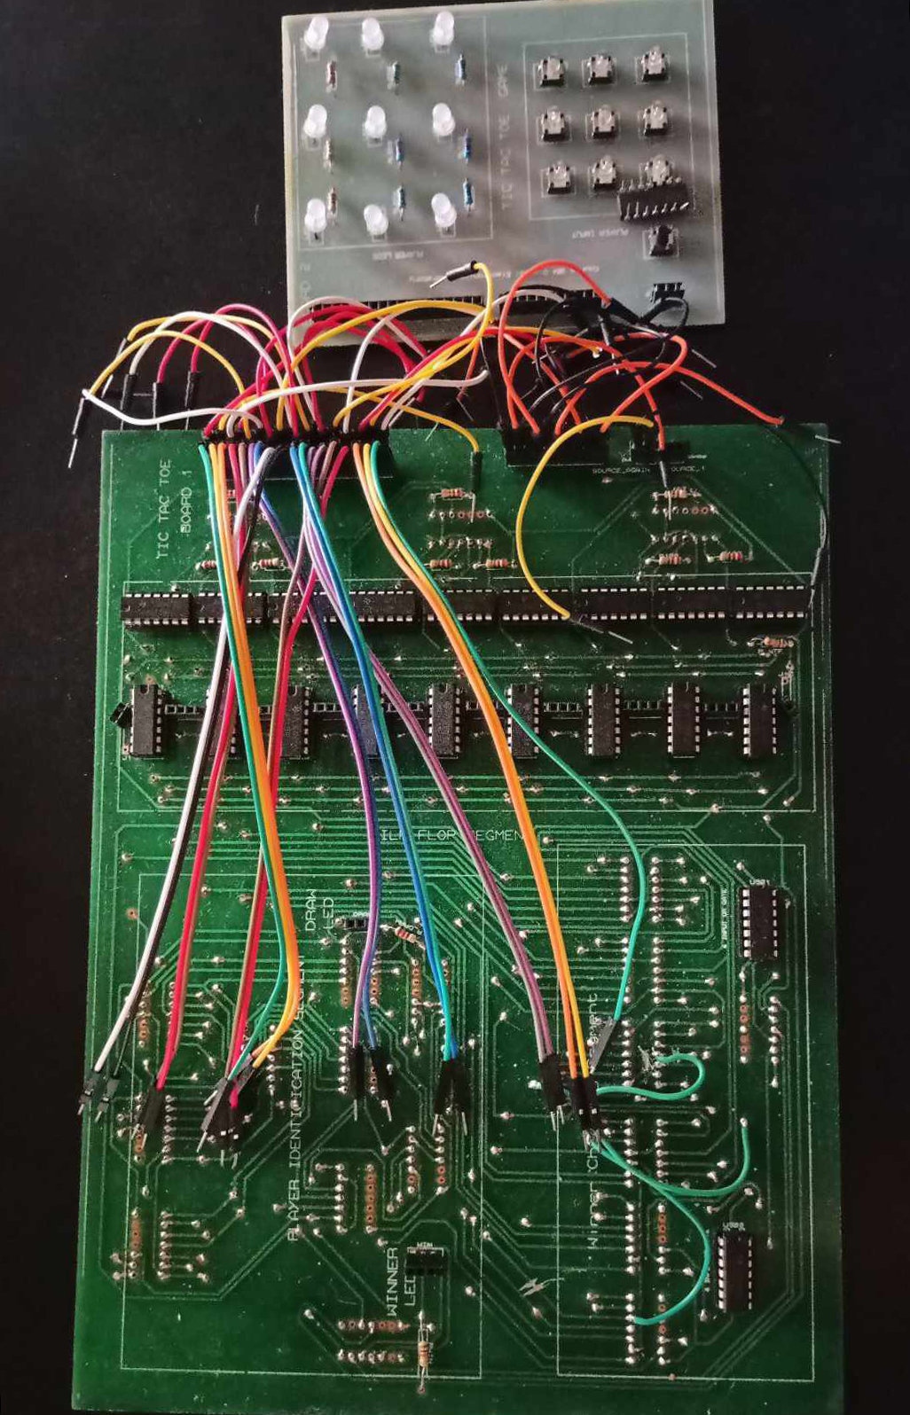
Outline
Summary
Design
Implementation
Analysis and Evaluation
References
Presented by: 1906059

Slide 3
1. Summary / Abstract
This project implements a commonly known game of Tic Tac Toe using digital logic design.
Two players can start the game where each player is designated a certain color of bicolor LEDs.
Once a LED has been pressed using a pushbutton, that LED cannot be pressed again and hence cheating in the game is not a possibility.
When a certain player wins, the winning LED turns on indicating that the game is over.
When the game is drawn, the draw LED is turned on
Once the game is over, no other pushbuttons will respond until the reset button is pressed and the game restarts.
Presented by: 1906059

Slide 4
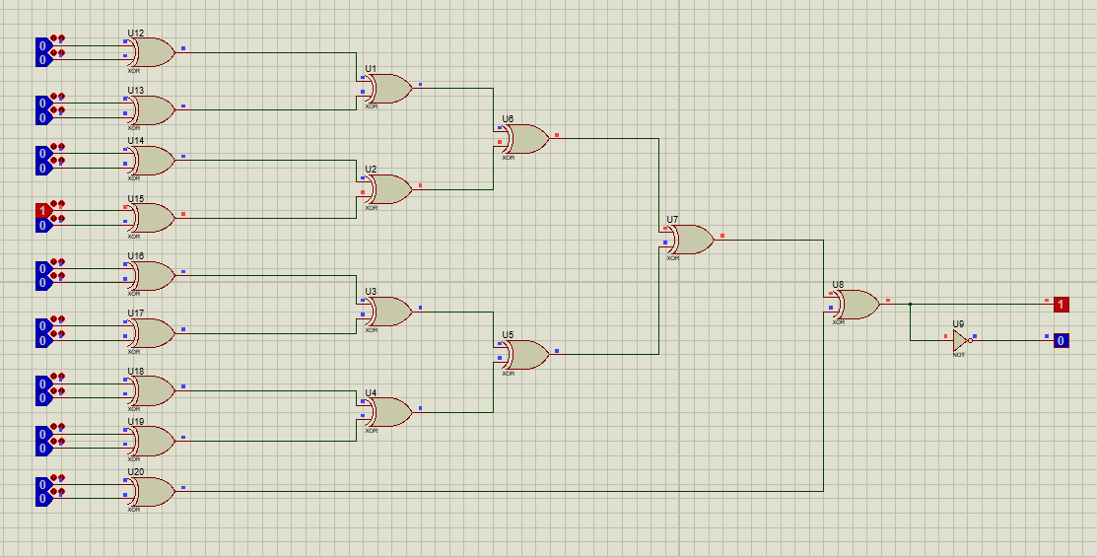
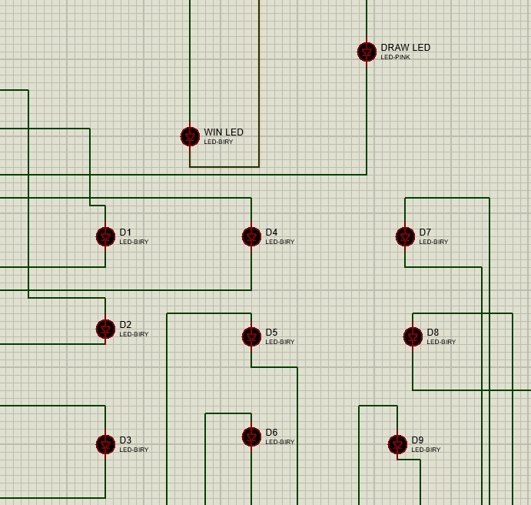
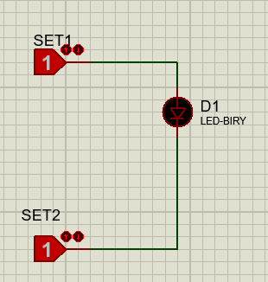
2.1 Design: Identifying players
XOR gate combination is used to identify the players
For odd number of pushbuttons pressed, output will be 1 and 0 (Player 1) and for even
number of pushbuttons, the output will be 0 and 1 (Player 2)
LED combination with
Winning LED (bicolor) and Draw LED (Unicolored)
Bi-Color LEDs are being used
Presented by: 1906059

Slide 5
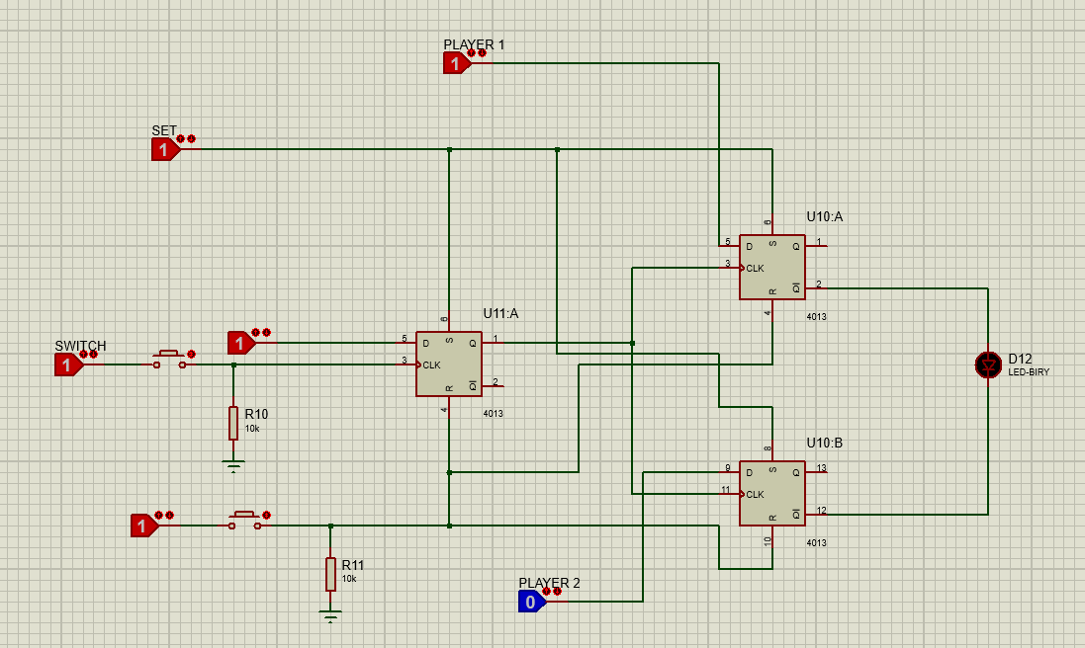
2.2 Design: Storing player data
When the switch is pressed, the output LED becomes high. The flipflop in the middle stores the data of the switch getting pressed and later, no matter how many times the button is pressed, the output remains the same, giving the players no opportunity to cheat.
When reset button is pressed, all the flipflops are reset and the output LED becomes low.
9 flip flop combinations are available for all 9 LEDs
The outputs of the flipflops are brought
to the XOR gate combinations controlling the
LEDs
Presented by: 1906059

Slide 6
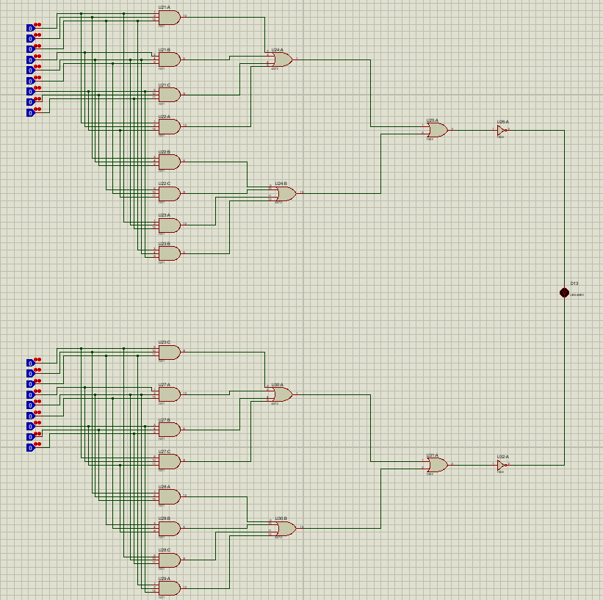
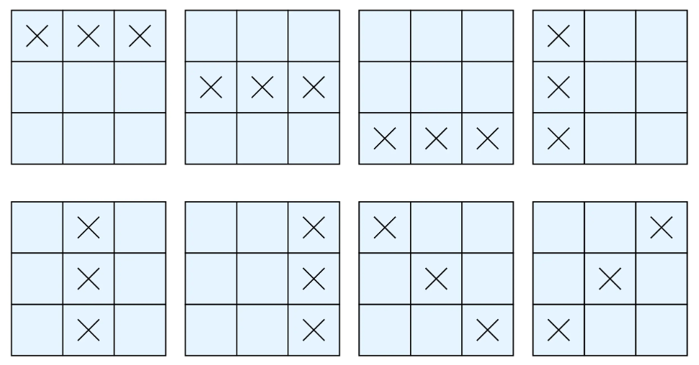
2.3 Design: Implementing winning combinations
8 different winning combinations are available. The output of the LEDs are input into the AND/OR gate combination that goes into the winning LED. When any winning combination is found, the winning LED is turned on.
(1 and 0 for player one and 0 and 1 for player two, giving two different colours for two players)
Presented by: 1906059

Slide 7
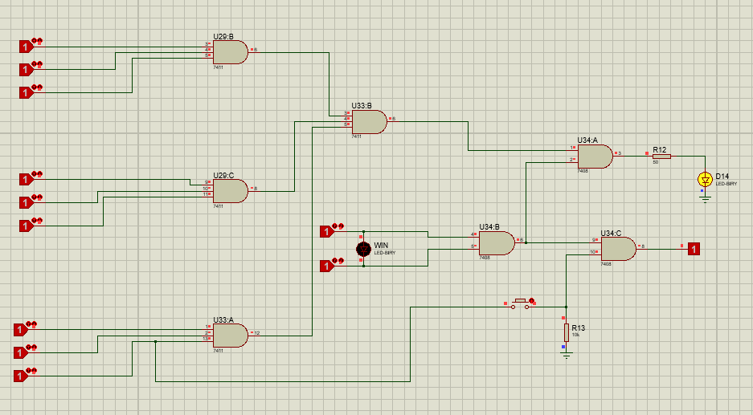
2.3 Design: Implementing Drawn game
When all buttons are pressed and the winning LED is low, the draw LED is turned on by a combination of and gates since the input to the final and gate will be high.
Presented by: 1906059

Slide 8
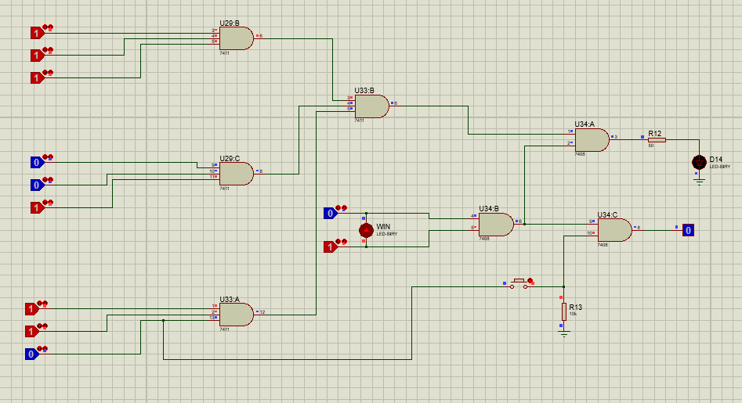
2.3 Design: Preventing additional switch pressing
Once the winning LED is turned on, any further pushbutton pressing needs to be avoided.
So, we use an AND gate before every flipflop input so that once the winning LED is turned on, its input becomes zero despite any other pushbuttons getting pressed.
Presented by: 1906059

Slide 9

2.3 Design: Simulation
Presented by: 1906059

Slide 10
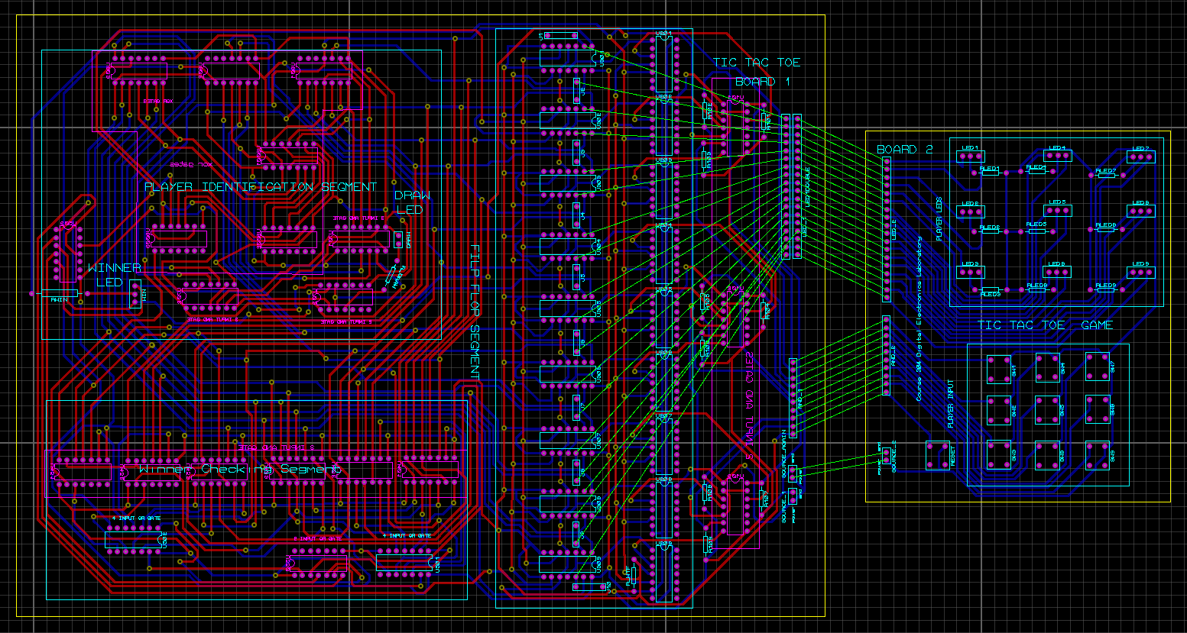
2.4 Design: PCB Layout and 3d rendering
Presented by: 1906055

Slide 11
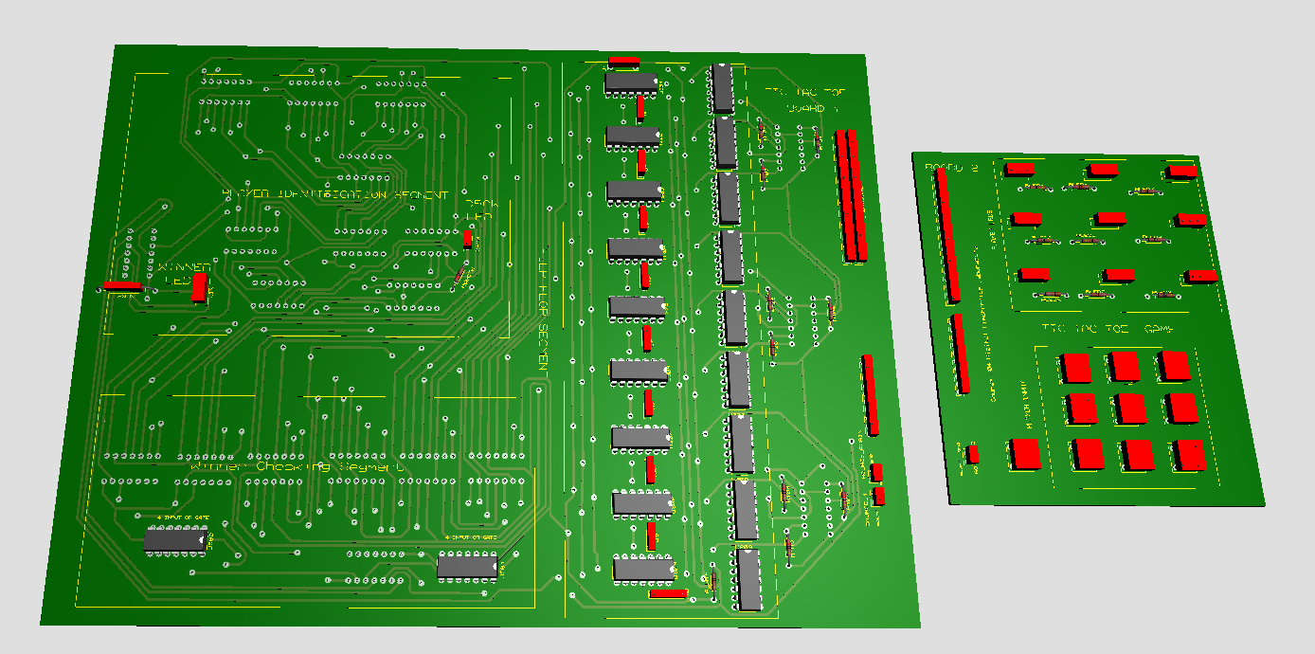
2.4 Design: 3d rendering
Presented by: 1906055

Slide 12
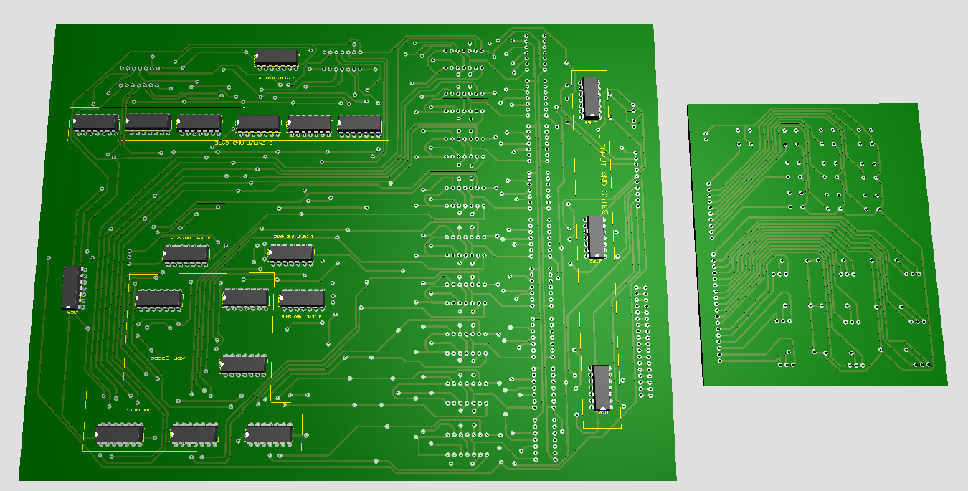
2.4 Design: 3d rendering (back side)
Presented by: 1906055

Slide 13
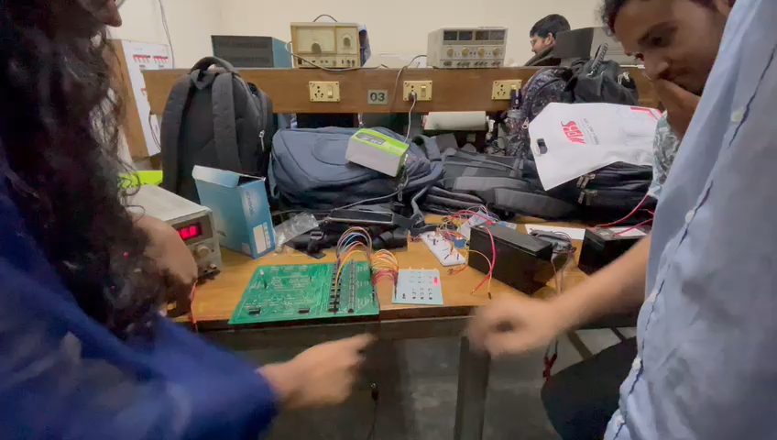
3 Implementation: Demonstration
Presented by: 1906055

Slide 14
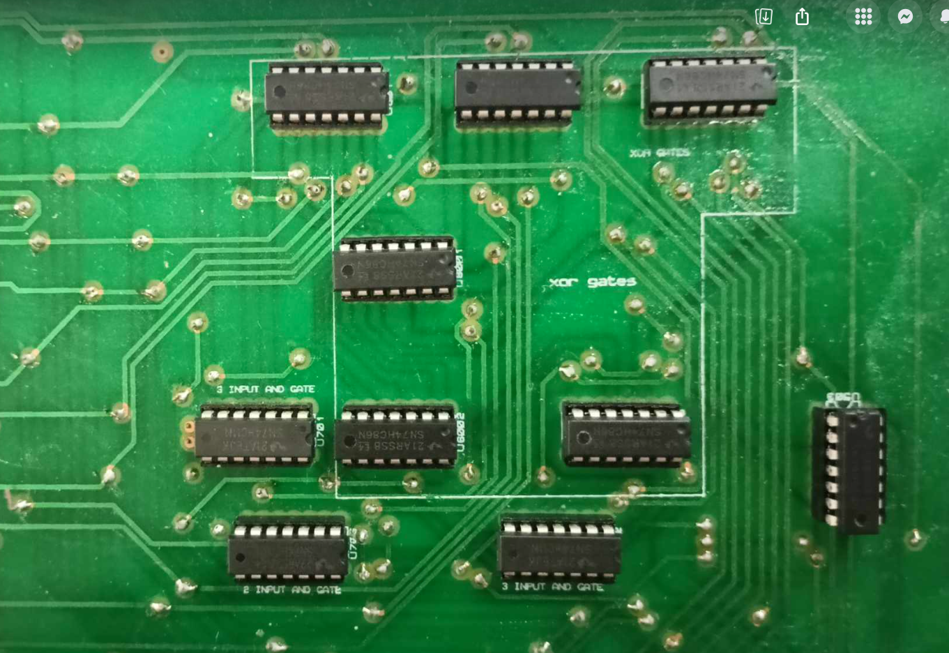
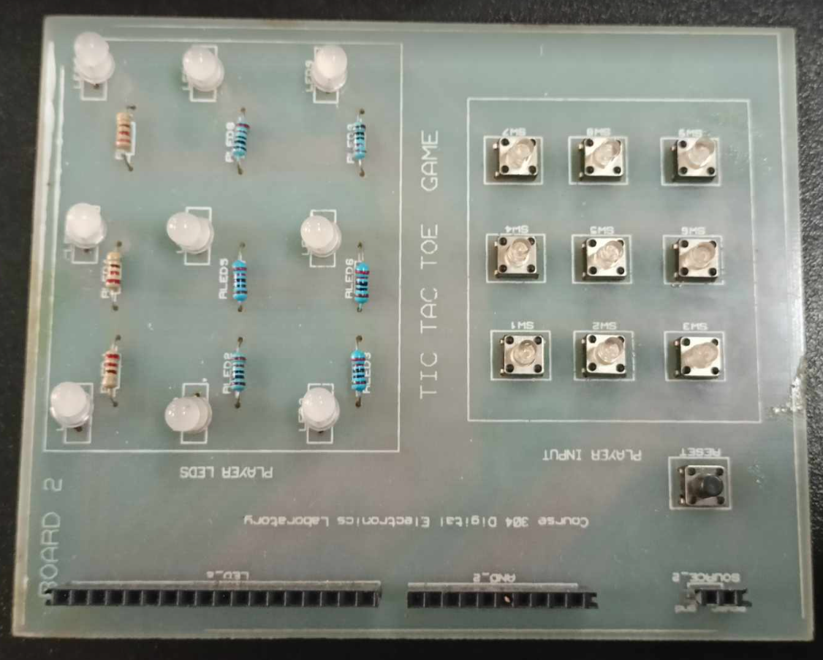
3.1 Implementation: Photo Gallery
Player Identification Segment c Game Interface
Presented by: 1906055

Slide 15
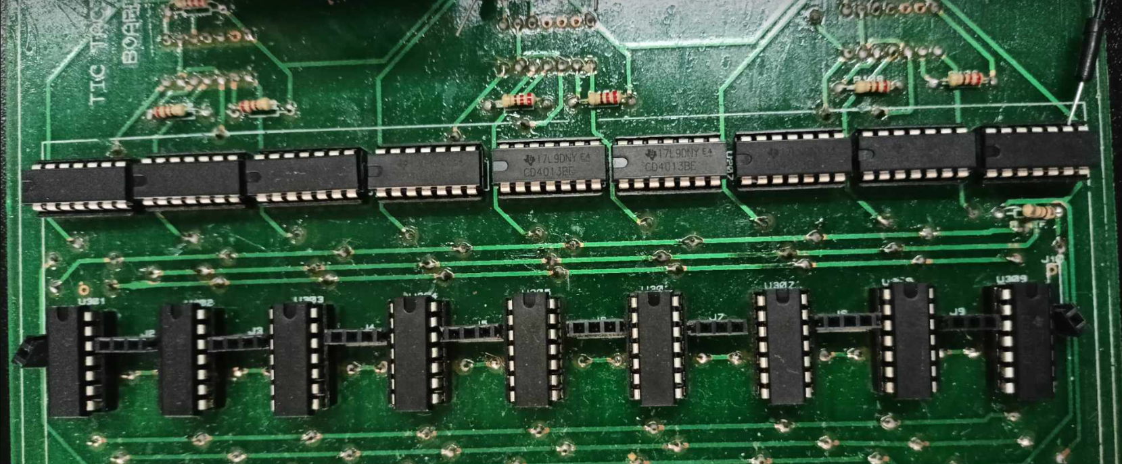
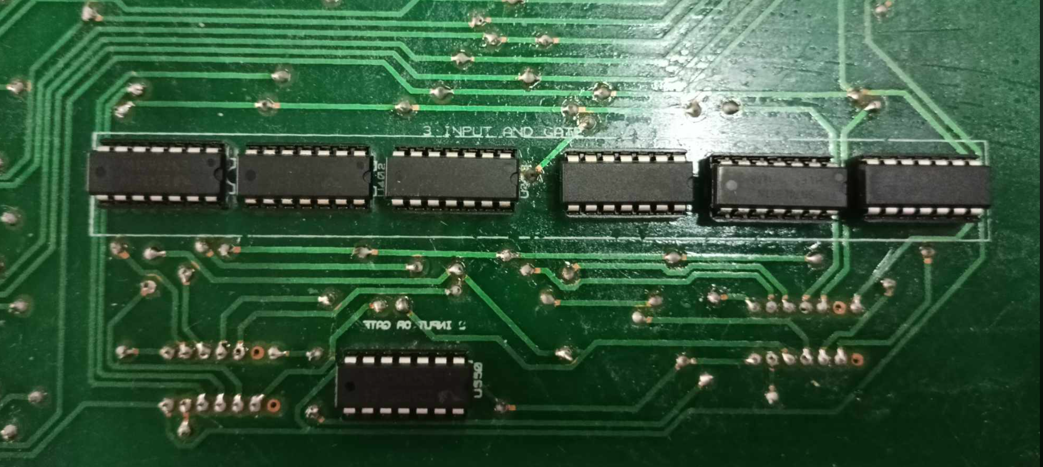
Flip Flop and AND gate segment for storing player information and thus controlling push button command validation.
3 Input AND gate segment for checking winning combinations for both the players
Presented by: 1906055

Slide 16
4. Analysis and Evaluation
4.1 Novelty
4.2 Project Management and Cost Analysis
4.3 Practical Considerations of the Design
4.4 Assessment of the Impact of the Project
4.5 Evaluation of the Sustainability
Presented by: 1906065

Slide 17
4.1 Novelty
Instead of designing it on software, creating a hardware based version of our traditional tic tac toe game allows people to interact with physical buttons to make their moves.
Our custom designed PCB is designed in a way that identifies the blocks which take input, the flip-flop block for saving input and preventing cheating, logic processing block for draws and wins, along with IC markers which identifies which IC goes where.
There is no scope for cheating i.e pressing a button twice or trying to force the game after a winner is decided.
The use of bicolored LEDs is a simple yet efficient way to identify winners without having to use any display.
A separate user interface
Low power consumption.
Presented by: 1906065

Slide 18
4.2 Project Management and Cost Analysis
Bill of Materials
Components | Per Unit Price (BDT) | Units
74HC86N | 25 | 6
74HC08N | 25 | 4
74HC32N | 25 | 1
74HC04N | 25 | 1
74HC11N | 25 | 8
CD4072BE | 60 | 2
CD4013B3 | 30 | 18
14 PIN DIP IC SOCKETS | 5 | 45
220 OHM RESISTANCE | 1.5 | 2
Common Anode LED | 6 | 10
Single colored LED | 5 | 1
Jumpers | 100 | -
PCB | 2000 | -
Soldering | 3200 | -
Total (BDT) | 6753
Presented by: 1906065

Slide 19
4.3 Practical Considerations of the Design
5.3.1 Considerations to public health and safety
We’ve used headers to solder components into PCB to easily replace any damaged IC.
Voltage level required is around 5V to prevent electric shock hazards.
Clear labelling that identifying different parts of the PCB.
5.3.2 Considerations to environment
Low power design hence consume less energy.
Repairable with components fitted on headers and marked for users to easily identify regions of issue and make changes.
Moderately bright LEDs for visual ease.
5.3.3 Considerations to cultural and societal needs
Allows two person interaction encouraging social engagement.
Can be customized by using different coloured LEDs
Presented by: 1906065

Slide 20
4.4 Assessment of the Impact of the Project
5.4.1 Assessment of Societal Issues
Addresses digital logic design literacy gap
Scope of entertainment, bonding and stress relieve beyond digital screens.
5.4.2 Assessment of Health and Safety Issues
Offers safety from electrical hazards due to low power consumption and max 5V supply.
5.4.3 Assessment of Legal Issues
The project does not infringe on copyright materials, utilizing open source resources available on the internet.
5.4.4 Assessment of Cultural Issues
Challenges traditional tic-tac-toe games played on digital platforms with a hardware alternative.
Presented by: 1906065

Slide 21
4.5 Evaluation of the Sustainability
5.5.1 Evaluation of Sustainability
We use IC sockets. Therefore, if there are any damaged ICs, we can easily replace them without replacing the PCB board. Therefore, less metallic and electrical waste is produced. The design is sustainable as it has a longer life span.
5.5.2 Evaluation of Impact of Design in Societal Context
Tackles the literacy gap when it comes to digital logic design and digital logic circuitry
Interactive design for attracting buyers and allowing people to interact and bond.
5.5.3 Evaluation of Impact of Design in Environmental Context
Energy efficient design with a 5V source.
Two separate boards ensuring that the entire circuitry doesn’t have to be replaced.
IC sockets allows us to replace defective ICs and not replace the entire board.
Presented by: 1906056

Slide 22
5. References
Making a Tic Tac Toe using digital logic design by Rashedul Haq. (YouTube)
Tic Tac Toe Game (Sean Kirschke, Douglus Loper, Daniel Struck, Andrew Galczyk, Oakland University, Rochester MI)
Chapter 5: Fundamentals of Digital Logic with Verilog Design by Brown
Presented by: 1906056

